Slide 1



POKER GAME USING EXPECTIMINIMAX ALGORITHM
Team 一 07
Md. Rakibul Islam Rakib
191 1977 642
Md. Saifuzzaman Naim
191 2202 642
Shahriar Ahmad
201 2413 042
Md. Zubayer Ahmed
201 4073 642

Slide 2

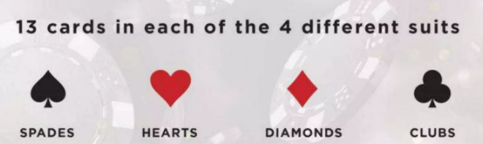
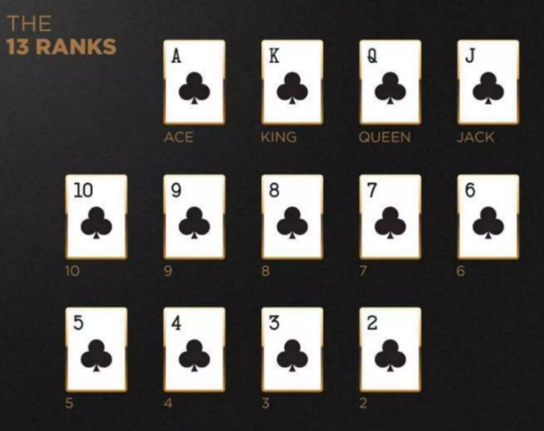
POKER GAME
What is it?
A card game played with a standard 52-card deck.
How to play?
Make the best five-card hand using :
2 private cards (dealt to each player)
5 community cards (shared and dealt).
Why Texas Hold’em?
Hold’em has evolved as the most popular poker game worldwide.
©️ Group 07 一 Md. Rakibul Islam Rakib | Md. Saifuzzaman Naim | Shahriar Ahmad | Md. Zubayer Ahmed.

Slide 3

GOALS AND OBJECTIVES
01
To design the environment.
02
To develop poker game with Expectiminimax.
03
To evaluate the performance of the Expectiminimax algorithm efficiently.
04
Simulate the game with a UI.
©️ Group 07 一 Md. Rakibul Islam Rakib | Md. Saifuzzaman Naim | Shahriar Ahmad | Md. Zubayer Ahmed.

Slide 4

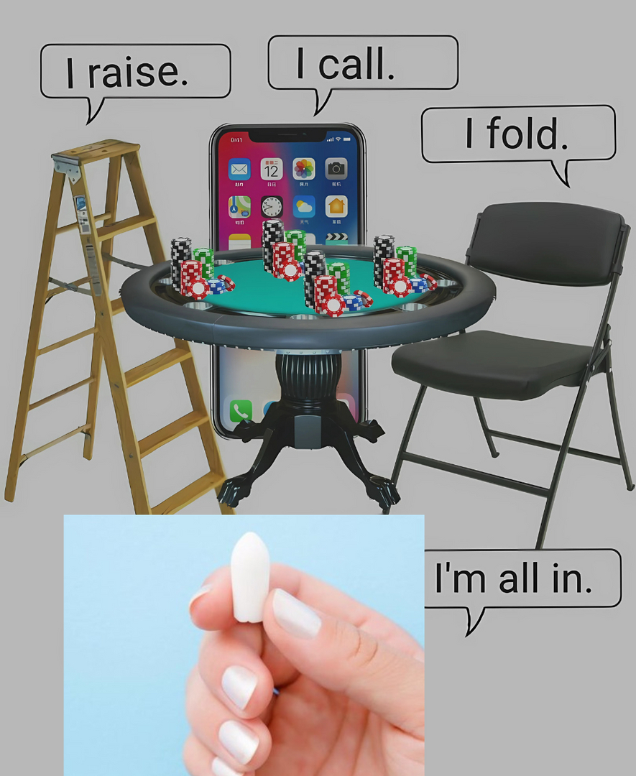




GAME ENVIRONMENT
(BASIC MOVES 一 ACTIONS)
Raise
Call
Fold
Check
©️ Group 07 一 Md. Rakibul Islam Rakib | Md. Saifuzzaman Naim | Shahriar Ahmad | Md. Zubayer Ahmed.

Slide 5








GAME ENVIRONMENT
(BASIC MOVES 一 GAME PHASES AND COMPONENTS)
Phases :
Components :
Preflop
Cards
Flop
Deck
AI Players
Turn
River
Betting Rounds
©️ Group 07 一 Md. Rakibul Islam Rakib | Md. Saifuzzaman Naim | Shahriar Ahmad | Md. Zubayer Ahmed.

Slide 6




CURRENT PROGRESS
Environment Setup
Basic Game Logic
Challenges Faced
Card, Deck, Player classes completed
Hand dealing & community cards implemented
Hand evaluation, AI strategy integration
©️ Group 07 一 Md. Rakibul Islam Rakib | Md. Saifuzzaman Naim | Shahriar Ahmad | Md. Zubayer Ahmed.

Slide 7
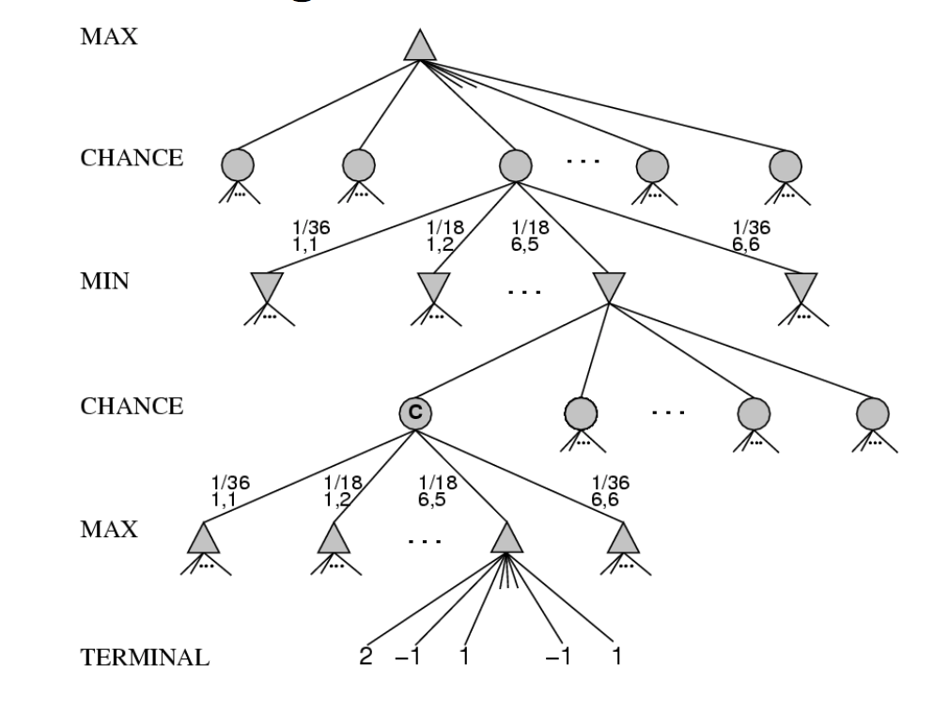
EXPECTIMINIMAX ALGORITHM OVERVIEW
01
02
03
AI evaluates possible hands & opponent actions
Uses probability-based decision-making
Incorporates randomness for uncertain outcomes
Implementation
01
02
03
Recursive search strategy
AI decision tree construction
Probability calculations for uncertain events
©️ Group 07 一 Md. Rakibul Islam Rakib | Md. Saifuzzaman Naim | Shahriar Ahmad | Md. Zubayer Ahmed.

Slide 8
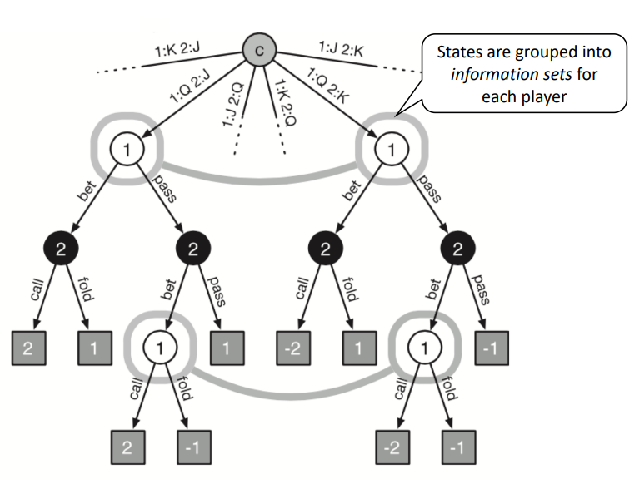
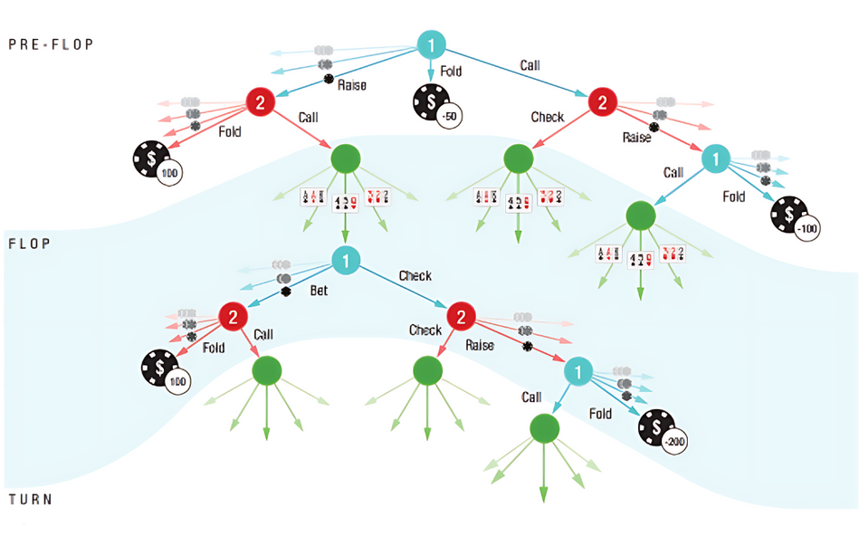
Methodology
The project employs a modular approach.
Expectiminimax algorithm implementation 一 using a recursive search strategy, considering the probabilities of uncertain events.
Performance evaluation 一 through simulation trials, comparing the win rates of AI players using Expectiminimax against those using simpler strategies.
©️ Group 07 一 Md. Rakibul Islam Rakib | Md. Saifuzzaman Naim | Shahriar Ahmad | Md. Zubayer Ahmed.

Slide 9
FUTURE PLANS
NEXT PLANS
Hand Evaluation
Expectiminimax Implementation
Betting Logic
Simulation and Evaluation
User Interface
©️ Group 07 一 Md. Rakibul Islam Rakib | Md. Saifuzzaman Naim | Shahriar Ahmad | Md. Zubayer Ahmed.

Slide 10
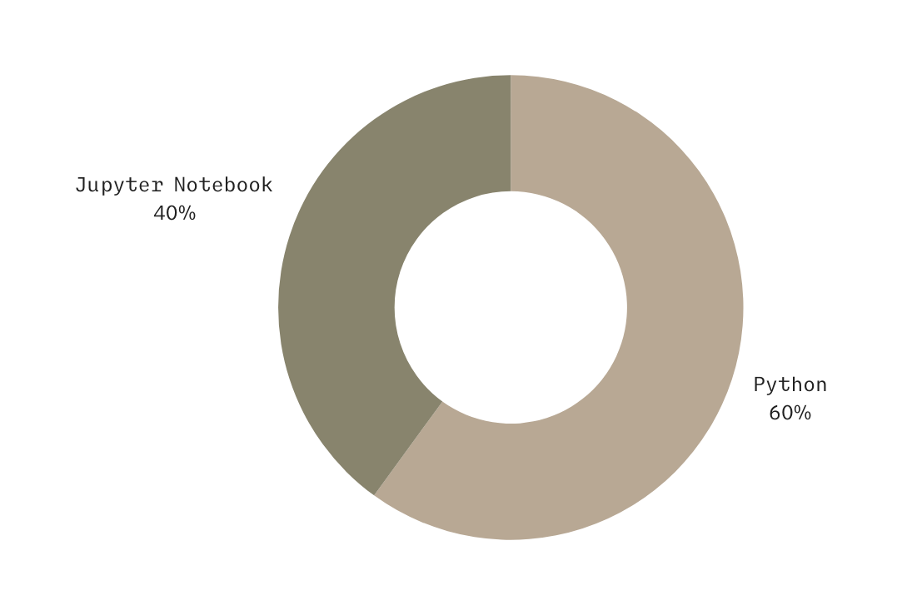
TOOLS
Language 一 Python
IDE 一 Jupyter Notebook
AI model 一 Expectiminimax
©️ Group 07 一 Md. Rakibul Islam Rakib | Md. Saifuzzaman Naim | Shahriar Ahmad | Md. Zubayer Ahmed.

Slide 11



EXPECTED OUTCOMES
01
AI plays optimally in uncertain scenarios
02
Comparison of Expectiminimax vs simpler strategies
03
Interactive poker simulation for research & learning
©️ Group 07 一 Md. Rakibul Islam Rakib | Md. Saifuzzaman Naim | Shahriar Ahmad | Md. Zubayer Ahmed.

Slide 12
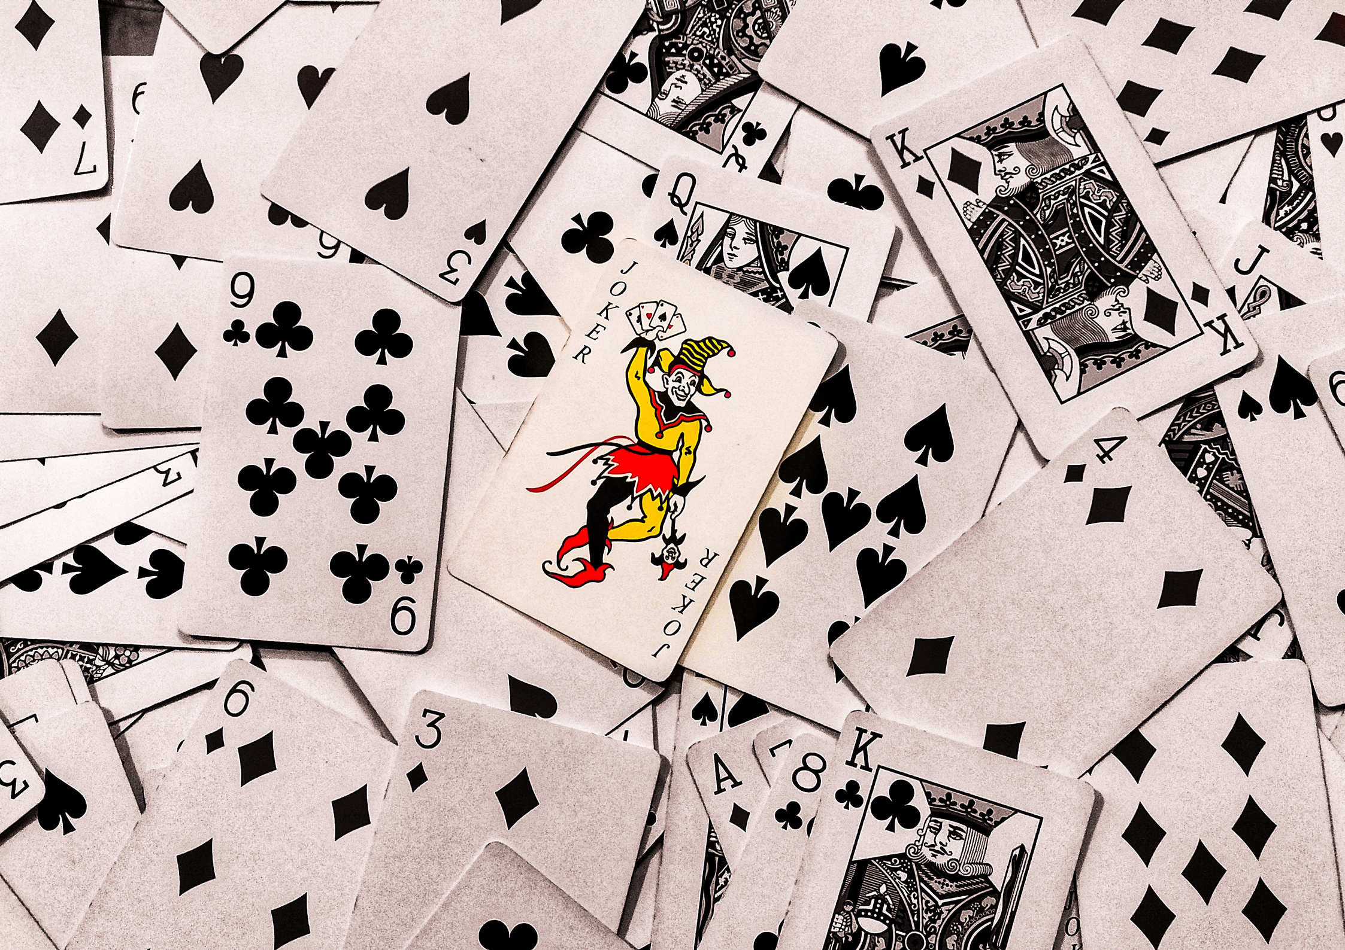
CONCLUSION
The project is currently in the initial development phase. The foundational components are established, and future efforts will focus on implementing the core game logic and the Expectiminimax algorithm. The successful completion of this project will provide a valuable tool for studying strategic decision-making in uncertain environments
©️ Group 07 一 Md. Rakibul Islam Rakib | Md. Saifuzzaman Naim | Shahriar Ahmad | Md. Zubayer Ahmed.

